Slide 1
Noisy Channel Model
w t
(w_{n}, w_{n-1}, … , w₁) (t_{m}, t_{m-1}, … , t₁)
Noisy Channel
Sequence w is transformed into sequence t.

Slide 2
Argmax
Argmax is a mathematical function.
It is typically applied to another function that takes an argument.
For example, given a function g() that takes the argument x, the argmax operation of that function would be described as follows:
result = argmax(g(x))
The argmax function returns the argument or arguments (arg) for the target function that returns the maximum (max) value from the target function.

Slide 3
Consider the example where g(x) is calculated as the square of the x value and the domain or extent of input values (x) is limited to integers from 1 to 5:
g(1) = 1^2 = 1
g(2) = 2^2 = 4
g(3) = 3^2 = 9
g(4) = 4^2 = 16
g(5) = 5^2 = 25
argmax(g(x)) = 5

Slide 4
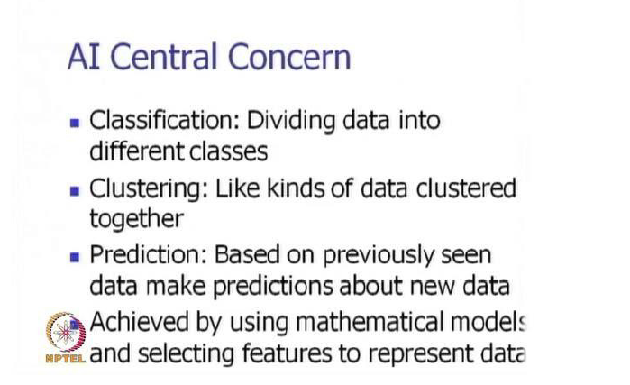

Slide 5
I went with my friend to the bank to withdraw some money but was disappointed to find it closed.

Slide 6
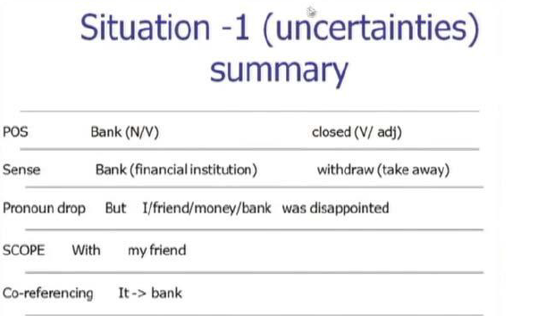

Slide 7
HMM

Slide 8
HMM
Hidden Markov Models (HMMs) are a class of probabilistic graphical model that allow us to predict a sequence of unknown (hidden) variables from a set of observed variables.
An HMM can be viewed as a Bayes Net unrolled through time with observations made at a sequence of time steps being used to predict the best sequence of hidden states.
It can be used to describe the evolution of observable events that depend on internal factors, which are not directly observable.
Notes:
Bayes' theorem, named after 18th-century British mathematician Thomas Bayes, is a mathematical formula for determining conditional probability. Conditional probability is the likelihood of an outcome occurring, based on a previous outcome occurring.

Slide 9
The Hidden Markov model is a probabilistic model which is used to explain or derive the probabilistic characteristic of any random process.
It basically says that an observed event will not be corresponding to its step-by-step status but related to a set of probability distributions.
Notes:
A Markov process is a stochastic process that satisfies the Markov property^{[1]} (sometimes characterized as "memorylessness"). In simpler terms, it is a process for which predictions can be made regarding future outcomes based solely on its present state and—most importantly—such predictions are just as good as the ones that could be made knowing the process's full history.^{[12]} In other words, conditional on the present state of the system, its future and past states are independent.

Slide 10
The states and observation are:
states = ('Rainy', 'Sunny')
observations = ('walk', 'shop', 'clean')
And the start probability is:
start_probability = {'Rainy': 0.6, 'Sunny': 0.4}

Slide 11
transition_probability = {
'Rainy' : {'Rainy': 0.7, 'Sunny': 0.3},
'Sunny' : {'Rainy': 0.4, 'Sunny': 0.6},
}
emission_probability = {
'Rainy' : {'jog': 0.1, 'work': 0.4, 'clean': 0.5},
'Sunny' : {'jog': 0.6, 'work: 0.3, 'clean': 0.1},
}

Slide 12
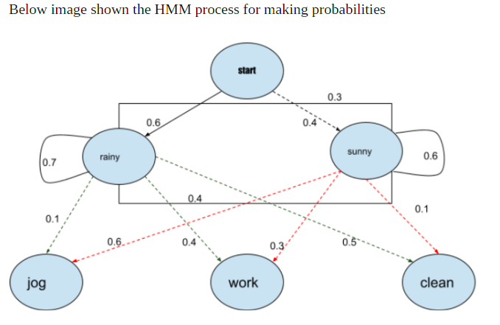

Slide 13
Reference
https://analyticsindiamag.com/a-guide-to-hidden-markov-model-and-its-applications-in-nlp/
https://medium.com/@postsanjay/hidden-markov-models-simplified-c3f58728caab#:~:text=A%20simple%20example%20of%20an,best%20sequence%20of%20hidden%20states.

